Slide 1
ATTITUDE REPRESENTATION
Attitude cannot be represented by vector in 3-dimensional space, like position or angular velocity, even though attitude is a “3-dimensional” quantity.
Attitude is always specified as a rotation relative to a base, or reference frame, just as vector position is specified as a displacement from a reference point. However there is often confusion in the direction:
  Rotation of the body frame to align with the reference frame
  Rotation of the reference frame to align with the body frame
Rotations are described by various means
  Direction Cosines Matrix (DCM)
  Euler Angles
  Euler Axis/Angle
  Quaternion
  Rodriquez parameters, Gibbs vector, etc.

Slide 2
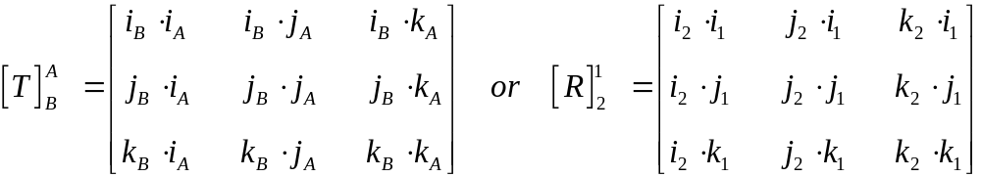
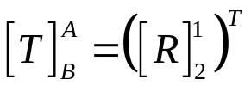
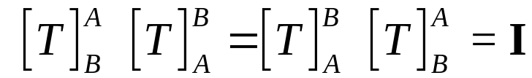
DIRECTION COSINES MATRIX
The DCM transforms a vector representation from one coordinate frame to another, or rotates vectors from one attitude to another.
The DCM can be formed by dot products of unit vectors of two frames
Note that if we set A=1 and B=2,
The nine elements are not independent because the DCM must be orthonormal

Slide 3
EULER ANGLES
Euler Angles are a particular sequence of three rotations about particular reference frame axes. Both the sequence and the axes must be specified to clearly define the attitude (rotation) of interest.
The same angle values used in a different sequence, or about different axes, results in a different attitude
Example: Yaw-Pitch-Roll Euler angle sequence rotating the reference frame (call it frame 1) into the body frame:
    1) - Yaw the reference frame about its k-axis with angle ψ to produce the 2-frame
    2) - Pitch about the new j-axis with angle θ to produce the 3-frame
    3) - Roll about the new i-axis with angle φ to produce the body frame B
    The resulting rotation matrix rotating 1-frame vectors v into their corresponding body frame position is given by

Slide 4
EULER ANGLE EXAMPLE
Yaw,Pitch,Roll (k,j,i) Sequence
i₃
Reference Frame is Frame 1
pitch
i₁
j₂
i₂
i₂
j₂,j₃
j₁
yaw
k₃
k₁,k₂
k₂
Rotate about k₁
i₃,i_{B}
Rotate about j₂
(angle ψ)
(angle θ)
roll
Rotate about i₃
j₃
Body frame is Frame B
(angle φ)
j_{B}
k_{B}
k₃

Slide 5
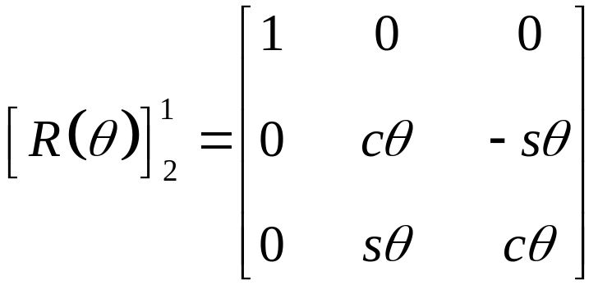
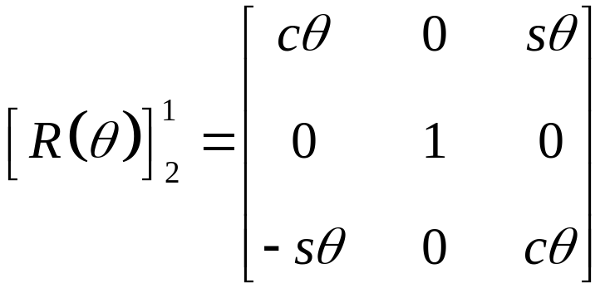
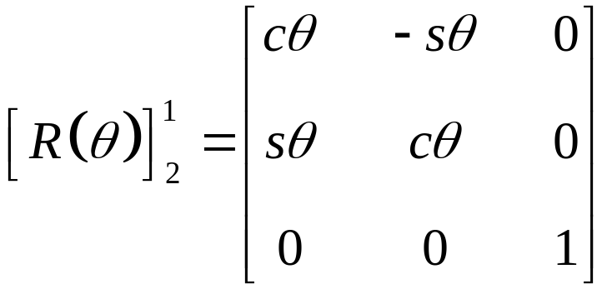
DCMs FOR GENERAL EULER ROTATIONS
2
i
θ
1
j
i
k
1
θ
j
i
2
1
k
j
θ
2
k

Slide 6
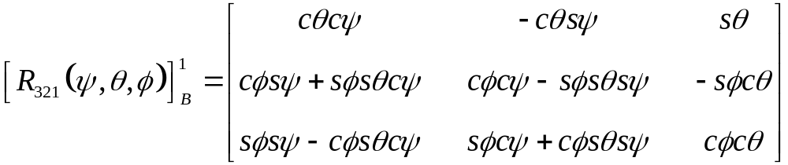
Transformation Matrix for Euler Yaw,Pitch,Roll (k,j,i)

Slide 7
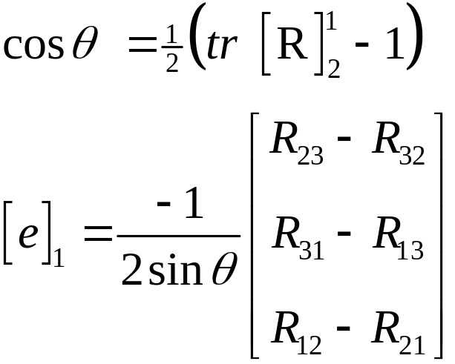

EULER’S THEOREM (EULER AXIS/ANGLE REP.)
Any rigid body rotation can be expressed by a single rotation about a fixed axis.
The rotation matrix [R] is given in terms of a unit vector along the “Euler axis” e (a unit vector), and the angle, θ
θ
Shuster, M., "Survey of Attitude Representations," Journal of Astronautical Sciences, Vol. 41, No. 4, Oct.-Dec. 1993. pp. 439-517.

Slide 8
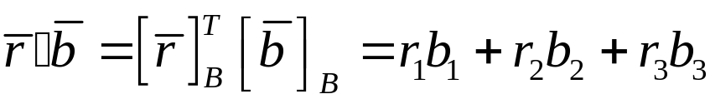
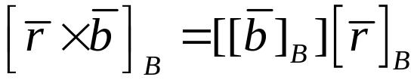
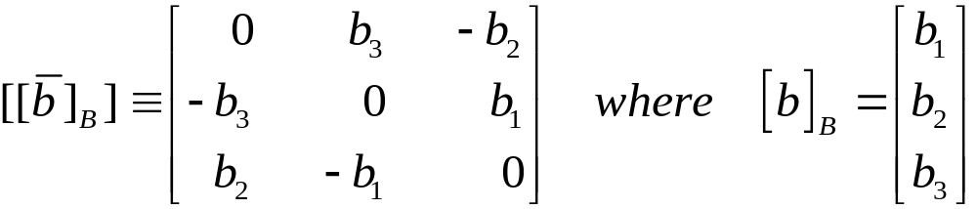
NOTATION
Vector Dot Product
Vector Cross Product
Cross Product Matrix for vector
cθ = cos(θ) sθ = sin(θ)

Slide 9
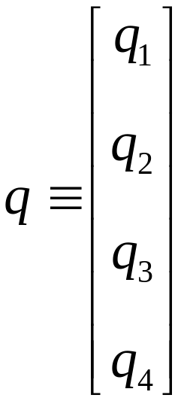
QUATERNION REPRESENTATION OF ATTITUDE
Only one redundant element requiring use of a constraint | q | = 1
Only ambiguity is a sign
Can be combined easily to produce successive rotations
DCM computation given by multiply & add of quaternion elements (no trig functions)
Propagation requires integration of only 4 kinematic equations
Widely used because of simplicity of operations and small dimension, together with lack of representation singularity
Shuster, M., "Survey of Attitude Representations," Journal of the Astronautical Sciences, Vol. 41, No. 4, Oct.-Dec. 1993. pp. 439-517.

Slide 10
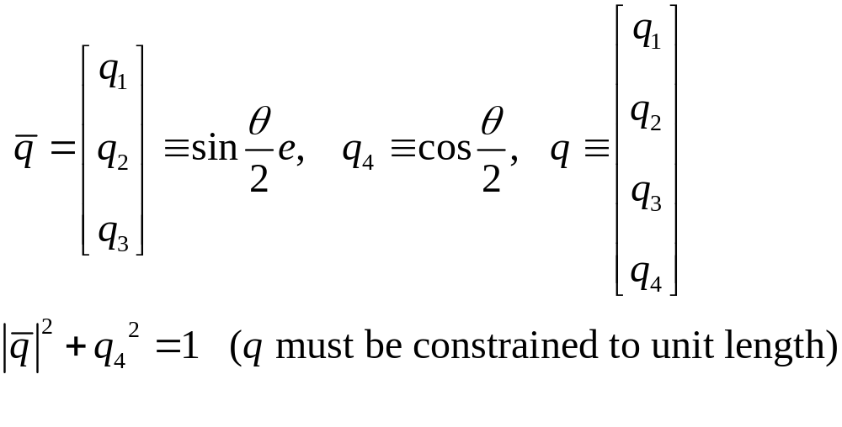
QUATERNION REPRESENTATION
Given Euler Axis e and angle θ

Slide 11
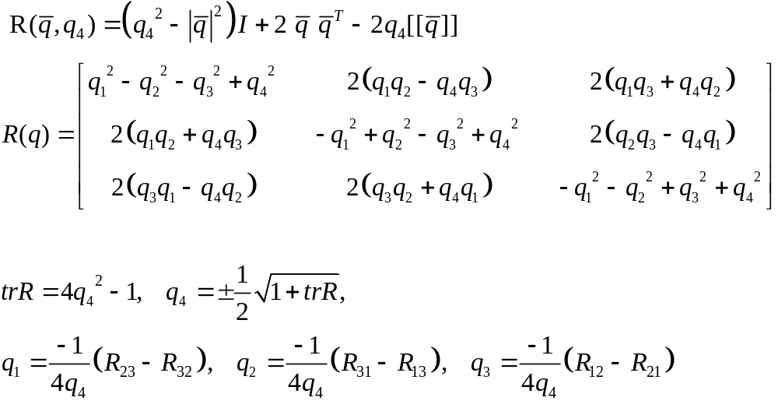
Quaternion versus Rotation Matrix (DCM_

Slide 12
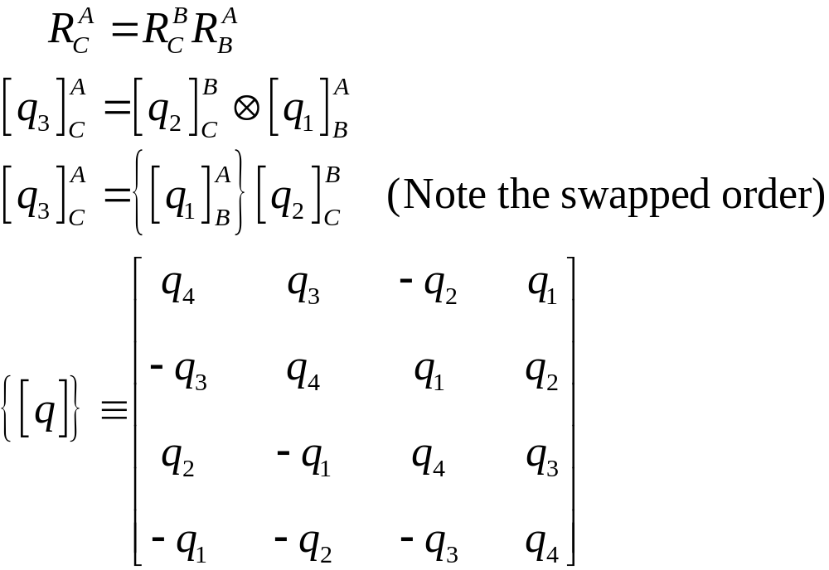
Quaternion Composition (Successive Rotations)

Slide 13
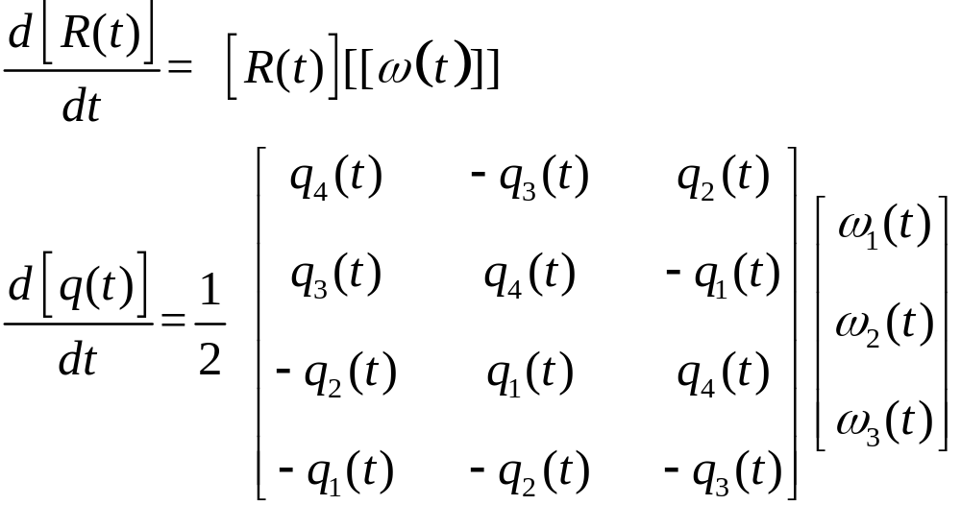
Kinematics
Relationship between angular velocity and attitude representations

Slide 14
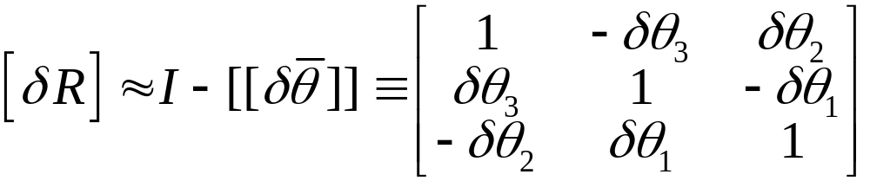
SMALL ANGLE APPROXIMATIONS
For a small angles δθ, sin(δθ) ~ δθ , cos(δθ) ~ 1
The rotation DCM for a sequence of three small Euler angles is:

Slide 15
ATTITUDE DETERMINATION PROBLEM
Use standard attitude sensors such as a star tracker or sun sensor
Sensor axes are calibrated with respect to body-fixed reference frame (B)
Direction to reference object (sun or star) is found in an inertial frame (I) using star catalog, ephemeris prediction, etc.
Direction to reference object is also measured by the on-board sensors and expressed in the (B) frame.
Now have one or more unit vectors to objects expressed in both (I) and in (B). Note that a minimum of 2 “independent” objects is required to determine 3-D attitude
Calculate the attitude DCM

Slide 16

ATTITUDE DETERMINATION PROBLEM
Given measurements of two unit vectors (pointing to two objects) in a body frame and a reference frame
How can the DCM representing attitude be determined? T must simultaneously satisfy
Deterministic method - TRIAD
  Use two of the measured vectors to define a set of three orthogonal unit vectors in the two frames.
  Create a matrix equation from the three vector equations and use this to solve for the attitude DCM

Slide 17
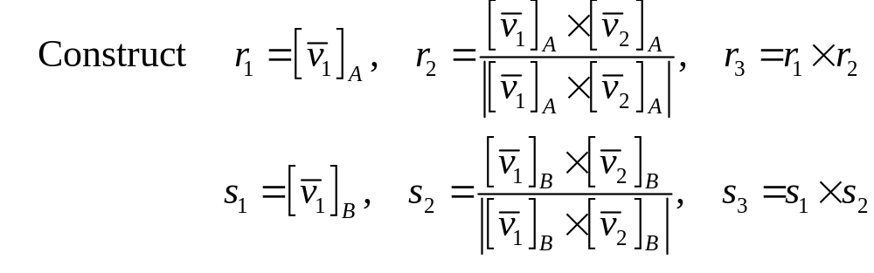
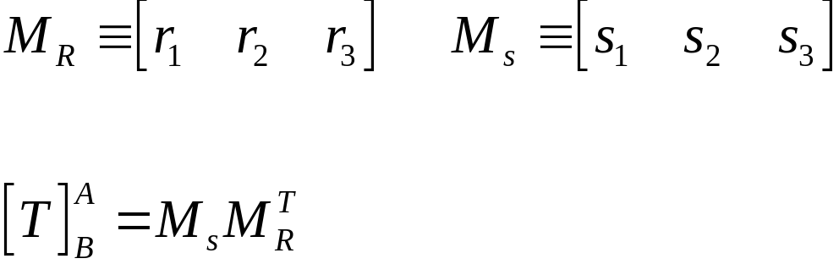

DETERMINISTIC ATTITUDE DETERMINATION
Transformation DCM estimate (note rotation DCM is the transpose of this)

Slide 18
Attitude Representations and Attitude Determination
REFERENCES
Shuster, M., "Survey of Attitude Representations," Journal of the Astronautical Sciences, Vol. 41, No. 4, Oct.-Dec. 1993. pp. 439-517.
Shuster, M. D. and Oh, S. D., "Three-Axis Attitude Determination from Vector Observations," Journal of Guidance and Control, Vol. 4, No. 1, Jan.-Feb. 1981, pp. 70-77.
Wertz, J. R., ed. Spacecraft Attitude Determination and Control, Kluwer Academic Publishers, Dordrecht, Netherlands, 1978.

